Slide 1

A Fusion Approach to Infrared and Visible Images
Date: 08 April 2021
Ms. RAHELA MAHENAZ : 17WH1A0595
Ms. P. DIVYA REKHA : 18WH5A0515
Ms. A. SRAVYA : 17WH1A0590
Internal Guide: Ms.G.NAGAMANI
Designation: Assistant Professor
Department of Computer Science & Engineering
BVRIT HYDERABAD College of Engineering for Women

Slide 2
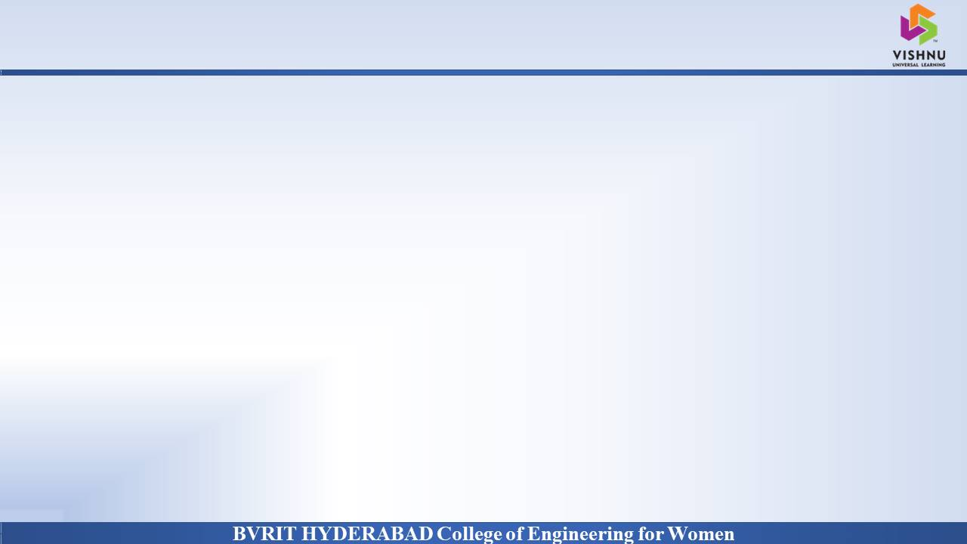
Why Should I Study this course?
PROJECT INTRODUCTION
DOMAIN
AI/ML
PROJECT TYPE
Existing System
In traditional CNN based network, with the increase of network depth, a degradation problem has been exposed and the information which is extracted by middle layers is not used thoroughly to address the degradation problem.
Proposed system
we present a novel deep learning architecture for infrared and visible images fusion problems. In contrast to conventional convolutional networks, our encoding network is combined with convolutional layers, a fusion layer, and dense block in which the output of each layer is connected to every other layer. We attempt to use this architecture to get more useful features from source images in the encoding process, and two fusion layers are designed to fuse these features.
Examples
BVRIT HYDERABAD College of Engineering for Women

Slide 3
Why Should I Study this course?
ABSTRACT
Examples
The infrared and visible image fusion task is an important problem in image processing field. It attempts to extract salient features from source images, then these features are integrated into a single image by appropriate fusion method. We are using a novel deep learning architecture for infrared and visible images fusion. In contrast to conventional convolutional networks, our encoding network is combined with convolutional layers, a fusion layer, and dense block in which the output of each layer is connected to every other layer.
BVRIT HYDERABAD College of Engineering for Women

Slide 4
Why Should I Study this course?
SYSTEM SPECIFICATIONS
Examples
ENVIRONMENT | SPECIFICATIONS
HARDWARE | Processor - Intel Core i3/I5 Memory(RAM) - 8 GB Storage – I TB
SOFTWARE | Python OS - Windows 10 Pycharm
BVRIT HYDERABAD College of Engineering for Women

Slide 5
Why Should I Study this course?
PROJECT PLAN
SNO | REVIEW | TOPICS
1 | I - Review | Software Requirements Specification Details of Features Architecture diagrams Data base / Data Source Base paper and reference
2 | II – Review | Review-I slides Data preprocessing Partial Implementation of features
3 | III – Review | Complete implementation Results & Discussions Project Report Draft
Examples
BVRIT HYDERABAD College of Engineering for Women

Slide 6
Why Should I Study this course?
REFERENCES
[1] Hui Li and Xiao-Jun Wu, DenseFuse: A Fusion Approach to Infrared and Visible Images, IEEE Transactions on image processing, Vol 28, No : 5, May 2019 [Base Paper]
[2] S. Li, X. Kang, L. Fang, J. Hu, and H. Yin, “Pixel-level image fusion: A survey of the state of the art”, Inf Fusion, vol. 33, pp. 100–112, Jan 2017.
[3] L. Wang, B. Li, and L.-F. Tian, “EGGDD: An explicit dependency model for multi-modal medical image fusion in shift-invariant shearlet transform domain,” Inf. Fusion, vol. 19, pp. 29–37, Sep 2014.
[4] D. P. Bavirisetti and R. Dhuli, “Two-scale image fusion of visible and infrared images using saliency detection,” Infr. Phys. Technol., vol. 76, pp. 52–64, May 2016
[5] Y. Liu, X. Chen, H. Peng, and Z. Wang, “Multi-focus image fusion with a deep convolutional neural network,” Inf. Fusion, vol. 36 pp. 191–207, Jul 2017.
Examples
BVRIT HYDERABAD College of Engineering for Women

Slide 7
Thank You
BVRIT HYDERABAD College of Engineering for Women

